Slide 1






Unveiling Insights: Used Car Analysis Dataset
Gdrive_EDA On Used Car
Github EDA On Used Car

Slide 2

Unveiling Insights: Used Car Analysis Dataset
Introduction
In this analysis, we examined a dataset of used cars to gain insights into their characteristics, pricing, and popular features.
The dataset underwent data preprocessing to handle missing, redundant, and inconsistent data.
Exploratory Data Analysis (EDA) was performed to answer specific questions related to the dataset.

Slide 3

Problem Statement
Developing an Optimal Used Car Price Prediction System for Cars Absolute
Key Objectives
Develop an Effective Used Car Price Prediction System: The team aims to create a robust and accurate prediction model that considers various features to estimate the selling price of used cars.
Boost Customer Confidence: By providing trustworthy and precise valuations, Cars Absolute seeks to instill confidence in potential customers, encouraging them to make informed buying decisions.
Revitalize Sales with Transparency: By offering competitive and transparent prices, Cars Absolute aims to rejuvenate its sales and regain its position in the competitive market.
Data Exploration
Analyze factors influencing used car prices.
Identify popular used car models.
Understand regional variations in demand.
Evaluate the impact of technological advancements.
Data Analysis Approach
Utilize advanced predictive modeling techniques.
Harness big data for accurate insights.
Consider a variety of features for prediction.
Expected Outcomes
Provide customers with a trustworthy car valuation.
Enable informed buying and selling decisions.
Empower Cars Absolute to thrive in the competitive market.

Slide 4
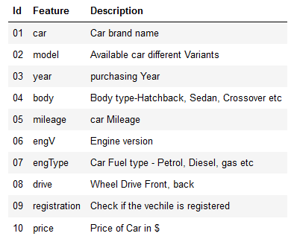
Data Acquisition & Description
Data Pre-Processing
Handled missing values in ‘Eng-V' and 'Drive' columns by adding the mode value.
Removed rows with missing values in the 'Price' column.
Removed duplicate rows, resulting in 113 duplicates being eliminated.
Updated incorrect 'mileage' values of 0 with the median value.¶
Created mileage bins to handle outliers and separately plotted the outliers.
Removed older data from before 1975 to reduce outlier impact.
Imputed missing price values by grouping by year and using the mean price for the specific year.

Slide 5
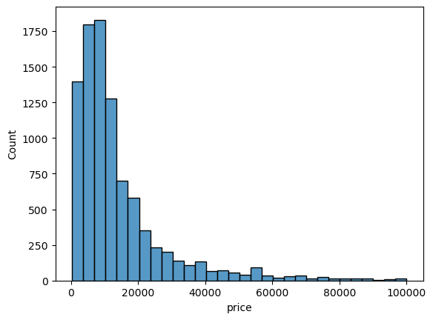
Exploratory Data Analysis
What is the distribution of car prices in the dataset?
Top 5 car prices and their corresponding counts:
$8500.0: 92
$6500.0: 86
$7500.0: 85
$3500.0: 82
$10500.0: 81

Slide 6
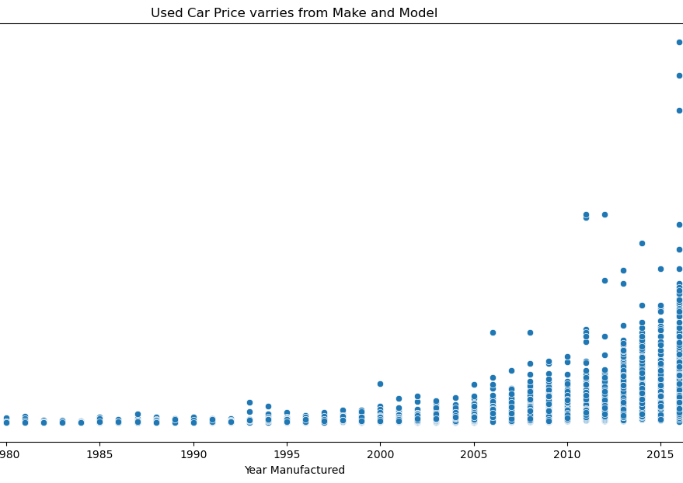
Exploratory Data Analysis
How does the price of used cars vary with respect to their make and model?
Price varies based on the year of manufacture, with more recent cars having higher values.
Bentley has the highest resale price, and most used cars for sale are from 2000 onwards.
Most used cars are priced below 2 million.

Slide 7
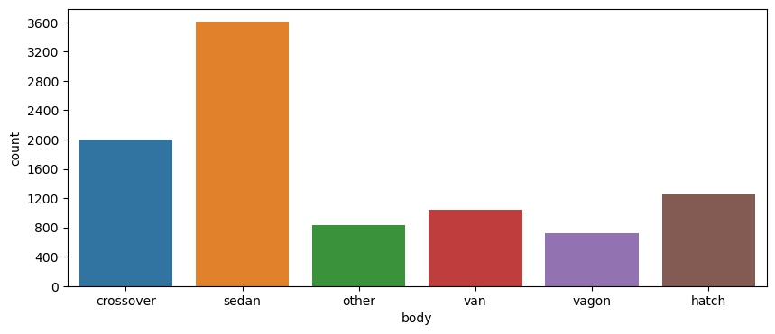
Exploratory Data Analysis
What are the most common car body types available in the dataset?
Sedan is the most common body type with 3600 cars for sale, followed by crossover with around 2000 cars.
wagon has very less cars on for sale

Slide 8
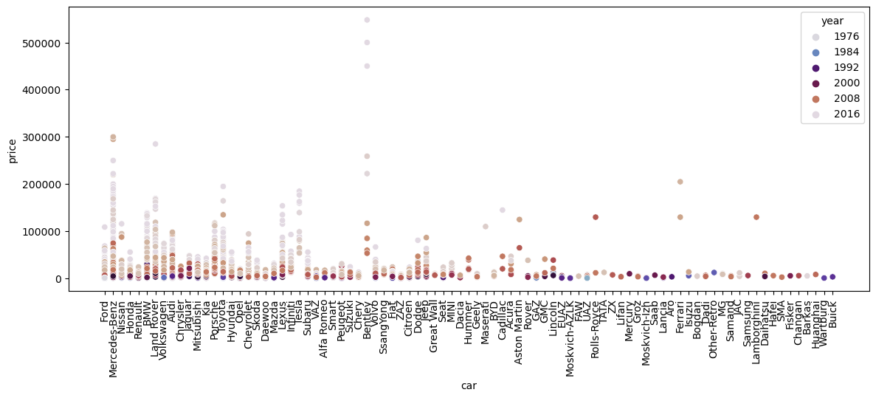
Exploratory Data Analysis
Are there any specific brands that tend to have higher resale value than others?
Bentley has the highest resale value.
The top 2 brands with high resale values are Mercedes-Benz and Land-Rover.
Toyota and Tesla have similar resale values.

Slide 9
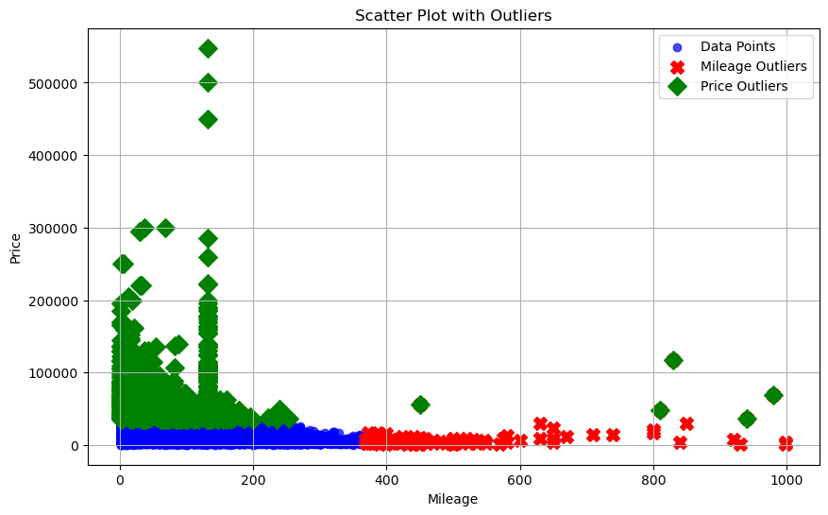
Exploratory Data Analysis
Are there any outliers in the mileage or price data? How do they affect the analysis?
Outliers were identified in mileage and price using interquartile range (IQR).
In the Green we can see Price Outliers
In the Red we can see the mileage Outliers

Slide 10
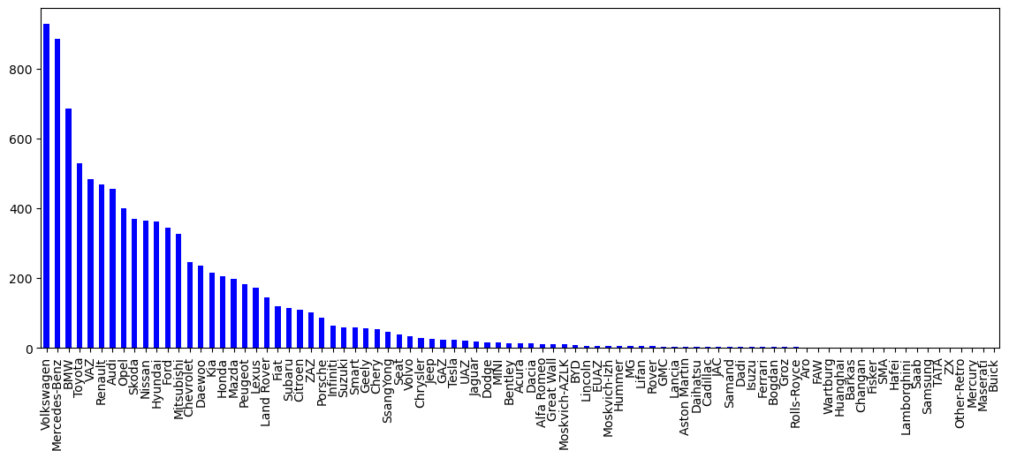
Exploratory Data Analysis
What is the average age of used cars in the dataset?
The average age of used cars in the dataset is approximately 16.38 years.
What is the distribution of purchases across different product categories?
Volkswagen and Mercedes-Benz are the most popular brands based on car counts.
Top 5 popular brands:
Volkswagen: 927 cars
Mercedes-Benz: 884 cars
BMW: 684 cars
Toyota: 529 cars
VAZ: 484 cars

Slide 11
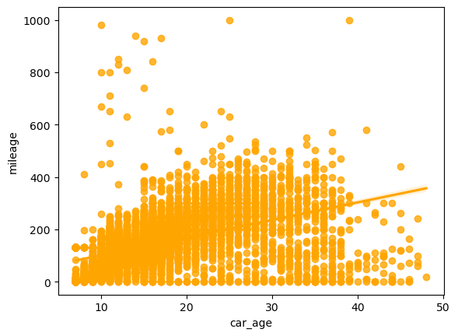
Exploratory Data Analysis
How does the mileage of used cars change as their age increases?
Mileage generally increases with the age of the car.

Slide 12
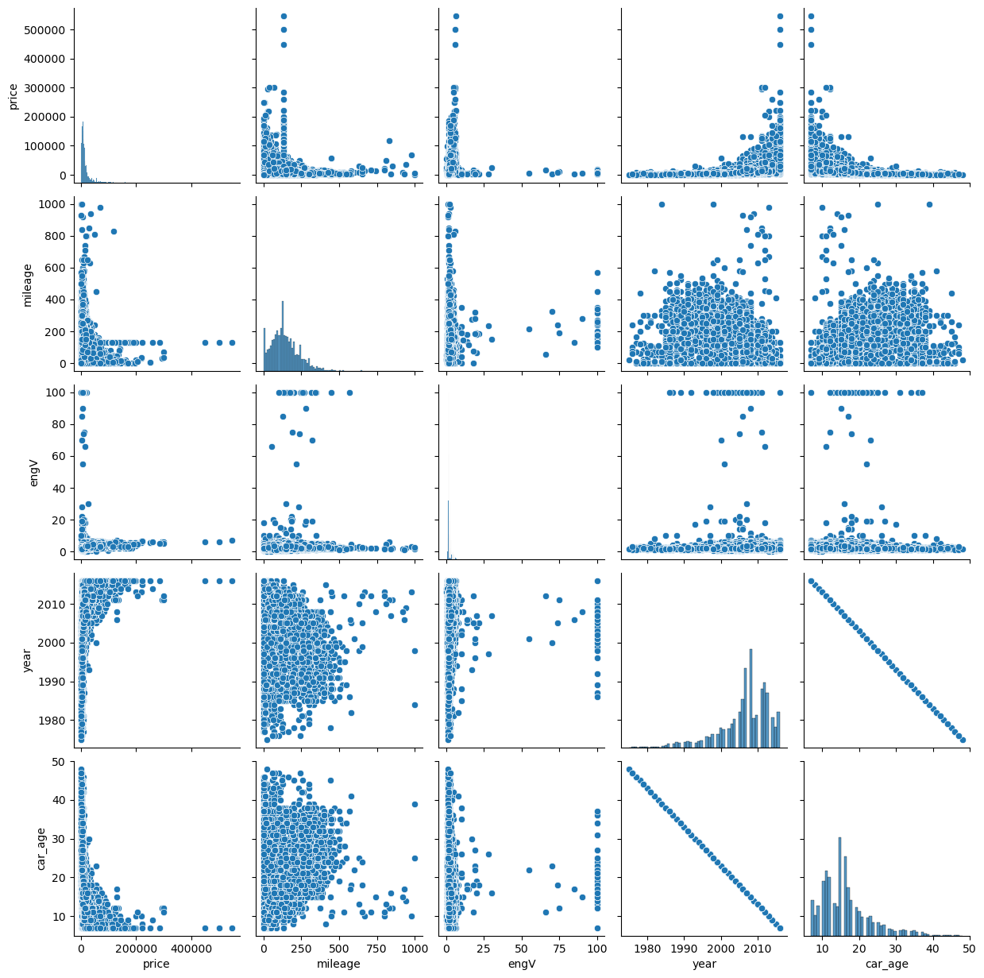
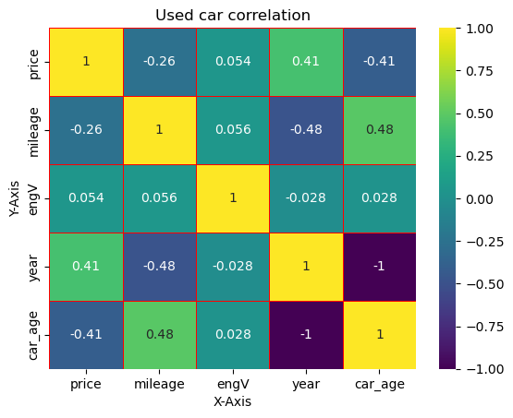
Exploratory Data Analysis
Is there a correlation between the age of the car and its price?
There is a negative correlation between the age of the car and its price.
The younger the car, the higher the price, and vice versa.

Slide 13
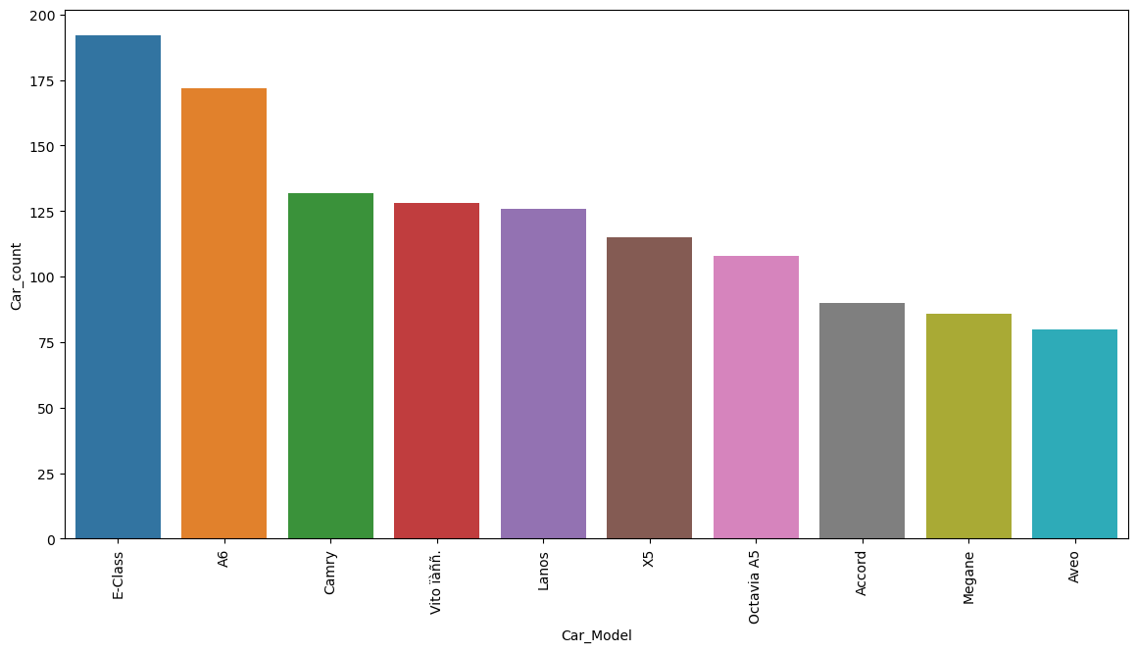
What are the most popular car in the dataset?
Most popular cars their sale
Car Model and their Car count sold
E-Class 192
A6 172
Camry 132
Vito ïàññ. 128
Lanos 126

Slide 14
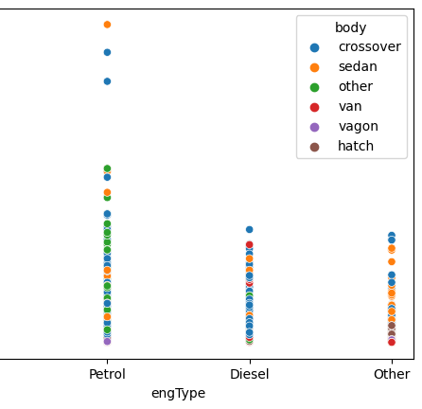
How does the price of used cars differ based on their engType?
Petrol variants have higher prices compared to gas variants, which generally have prices less than 100K

Slide 15
Summarization
The analysis of the used car dataset revealed important patterns, correlations, and preferences. By addressing data issues and conducting in-depth EDA, we gained valuable insights to optimize buying and selling strategies in the used car market.

Slide 16
Conclusion
This analysis provided valuable insights into the used car market.
Understanding factors affecting pricing, popular features, and car body types can help make informed decisions for both buyers and sellers.
Thank You
Actionable Insights
Consider targeting popular brands like Volkswagen and Mercedes-Benz for resale.
For sellers, focus on vehicles with lower mileage and newer manufacturing years to get better prices.
For buyers, explore affordable options among petrol variants for a cost-effective purchase.

